Slide 1
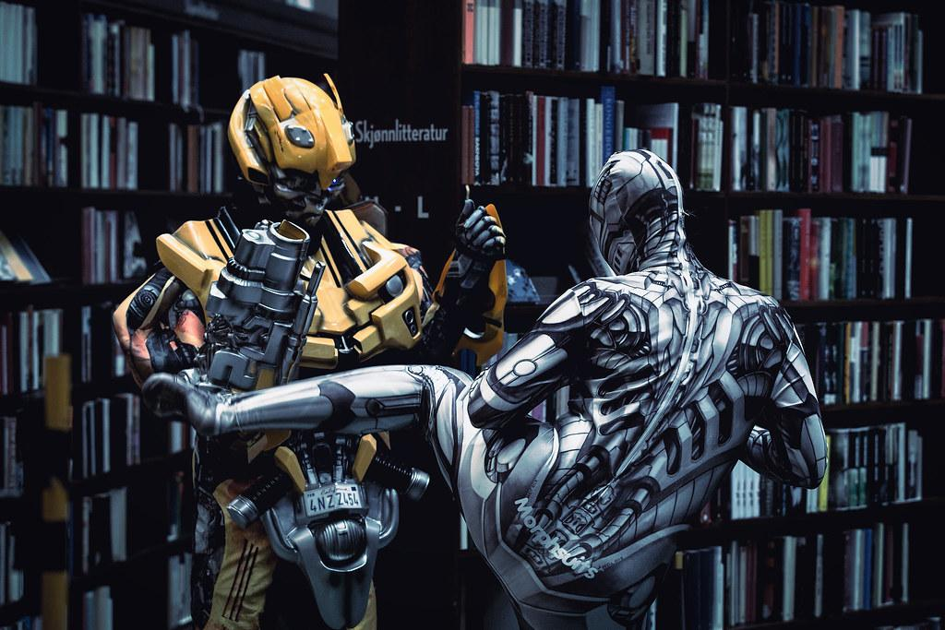
Generative Adversarial Networks: GANs
Cartoon Avatar Generator
Discriminator
Generator
John Wang 8845 john.wang@sjsu.edu MSAI
Jack Zhu 8128 jiali.zhu@sjsu.edu MSAI
Amy Phan 4572 amylan-anh.phan@sjsu.edu MSSE
David Archer 0770 guosheng.zhang@sjsu.edu MSAI

Slide 2
Architecture of Gan
Unsupervised Learning
Stack:
Dense/Conv2d Layer
Batchnormalization Layer
LeakyReLU layer
Output is Image
Generator
128x128x3
Noise Image
Generated Image
Stack:
Conv2d Layer
LeakyReLU Layer
Dropout Layer
Flatten Layer for T/F Output
Discriminator
128x128x3
Compare the two images
Real Image
Notes:
The image need to be preprocessed to a scale of 0-1. The discrimator is taking the generated image as input and compare with the real images dataset and make a final division of the image is real or not.
The generator iterating through a number of different cycles of creating samples image updating model until it can generated image to fool the discriminator or human. batchnormalization to prevent number got too big.

Slide 3
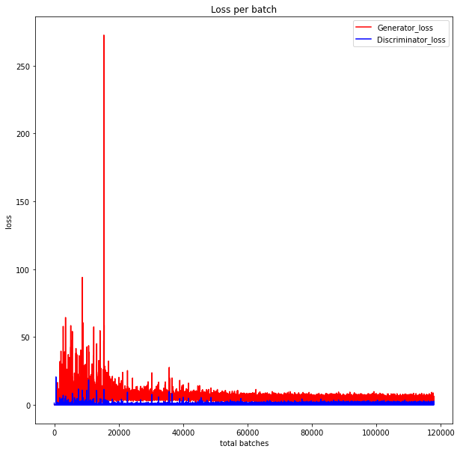
Discriminator And Generator
Generator
Learns to create realistic fake images
Takes in a vector of random numbers and generates new data instances
Discriminator
Takes in real and fake images
Determines whether the images generated by the generator is real or fake
Over time, the loss of the generator decreases and the loss of the discriminator increases
Notes:
Generator and discriminator loss
Both starts off very high
Generator can not generate images well yet
Discriminator can not tell the difference between real and fake images yet
Generator loss is higher than the discriminator because it it harder to generate images than to discriminate fake and real images
Over time, the loss of the generator decreases and the loss of the discriminator increases
The generator is getting better at generating images and fooling the discriminator

Slide 4
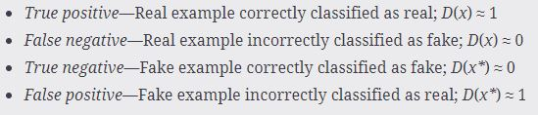
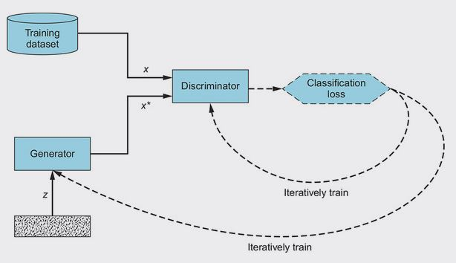
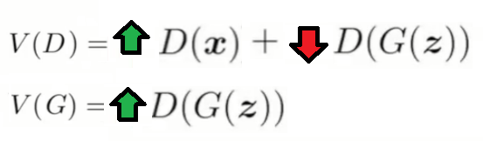
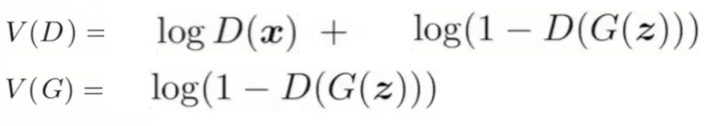
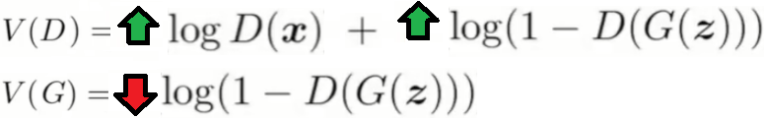
Binary Cross Entropy (0-1)
Loss function

Slide 5
Cartoonizer & Restorer
For generating a cartoonized face, we could use a GAN with neural network.
But also we can simply use some functions in OpenCV:
bilateralFilter()
drawContours()
and
clusterize the colors in the original image.
These can be handled by a single cartoonizer.py file

Slide 6
Cartoonizer & Restorer
For generating a restored face from an old or damaged photo,
We can use another GAN, GFP_GAN
which is based on BasicSR
and dedicated for face restoration.
We simplified the app as a single restorer.py file with a pretrained model

Slide 7
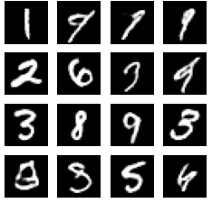
DCGANs
Notes:
This is the result from tensorflow with MNIST dataset. We fine tune it and run it 1000 epoch. From here, we use it as our first idea and prototype for the next step.

Slide 8
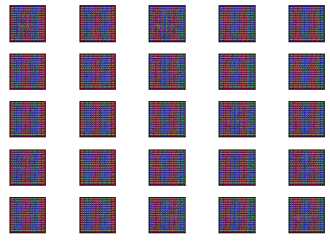
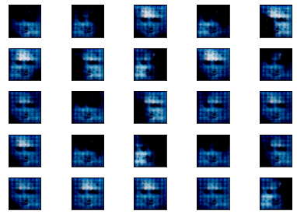
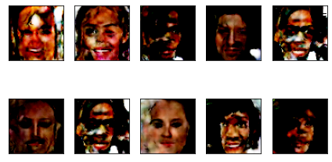
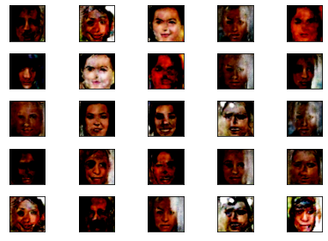
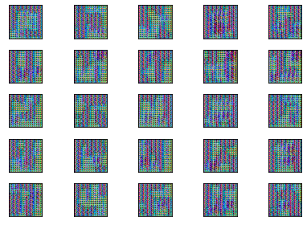
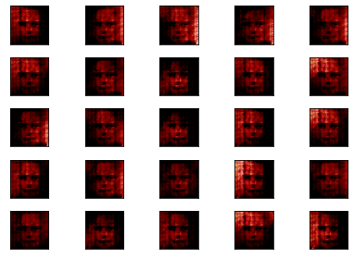
HomeBrew GANs
Model Collapse
(Strong discriminator)
Parasitic Cycling (Strong Generator)
Results Differ by Run - Some Golden Runs

Slide 9
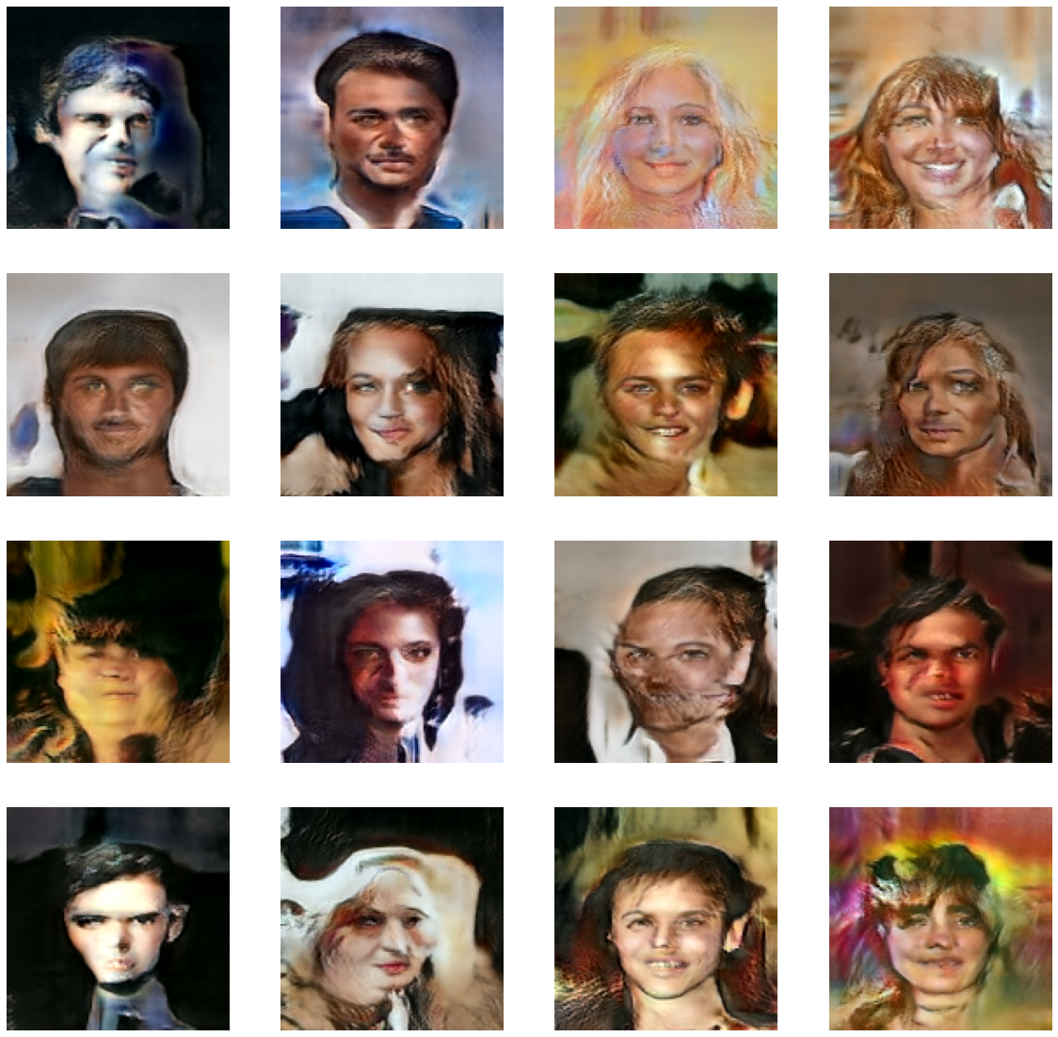
StyleGAN

Slide 10
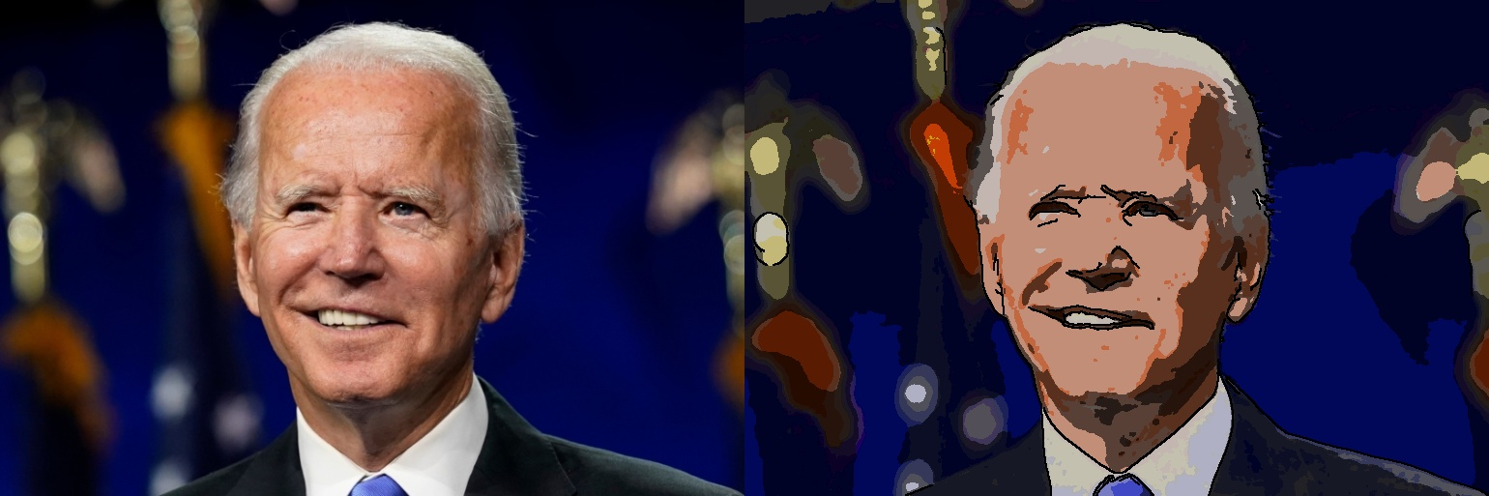
Cartoonizer

Slide 11
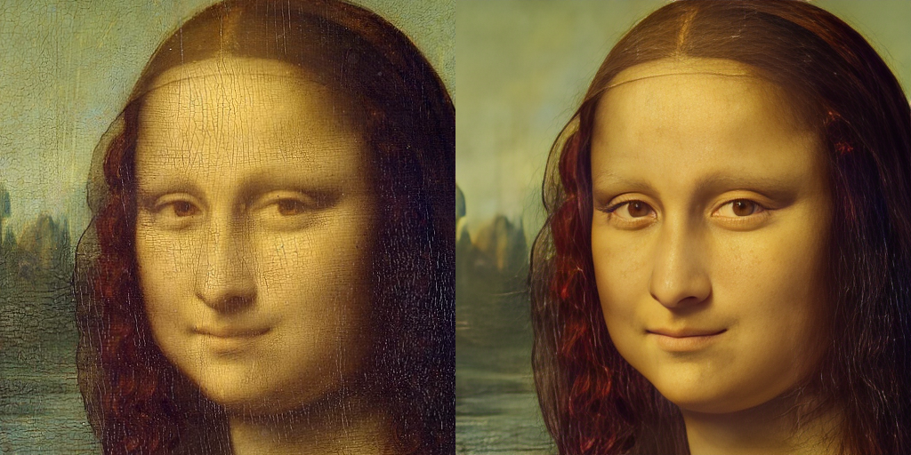
Restorer

Slide 12
References:
Github: https://github.com/johnwang21/CMPE-258-GAN
Ian J. Goodfellow, Generative Adversarial Networks, https://arxiv.org/abs/1406.2661
Tensorflow Team, DCGANs tutorial, https://www.tensorflow.org/tutorials/generative/dcgan
Nagesh Singh Chauhan, Noise GANs example, https://www.kaggle.com/code/nageshsingh/generate-realistic-human-face-using-gan
Sayak, DCGANs example, https://www.kaggle.com/code/sayakdasgupta/fake-faces-with-dcgans/
Himanshu Nayal, DCGANs example,https://www.kaggle.com/code/himanshunayal/human-face-generation-dcgans/notebook
Alec Radford, Unsupervised Representation Learning with Deep Convolutional Generative Adversarial Networks, https://arxiv.org/abs/1511.06434
Tero Karras, A Style-Based Generator Architecture for Generative Adversarial Networks, https://arxiv.org/abs/1812.04948
Soon-Yau Cheong, StyleGANs tutorial, https://keras.io/examples/generative/stylegan/
Xintao Wang, Towards Real-World Blind Face Restoration with Generative Facial Prior, https://arxiv.org/pdf/2101.04061v2.pdf
Vladimir Bok, GANs in Action, https://www.manning.com/books/gans-in-action

